Slide 1

School of Computing Science and Engineering
Program: B Tech
Course Code:BCSE3016
Course Name: Web Tech (PBL MODE)

Slide 2
School of Computing Science and Engineering
Project Name: Elegent Resturant Website
Team No. :4
Batch : 6
Student 1 Name :Harshita Anand
Student 2 Name :Prakhar Gupta
Student 3 Name :Ankur Singh

Slide 3
VINTAGE BITES
“People come here as Guests and leave as Friends”
“We serve the best Vintage Foods”
“We welcome You”

Slide 4
1.
PROBLEM SPECIFICATION
CONTENTS
2.
CONCEPT DEVELOPMENT
AND CONTENT PLANNING
3.
Content design and Screen
Shots
4.
Extra curriculum
Testing
5.

Slide 5

PROBLEM SPECIFICATION

Slide 6
In a places where local restaurants are not able to expand their businesses due to:
Outdated ways of promoting though FLYERS and CARDS.
Limited to a fixed range of locality .
Inefficient way of booking tables through phones.

Slide 7

CONCEPT DEVELOPMENT
AND
CONTENT PLANNING

Slide 8
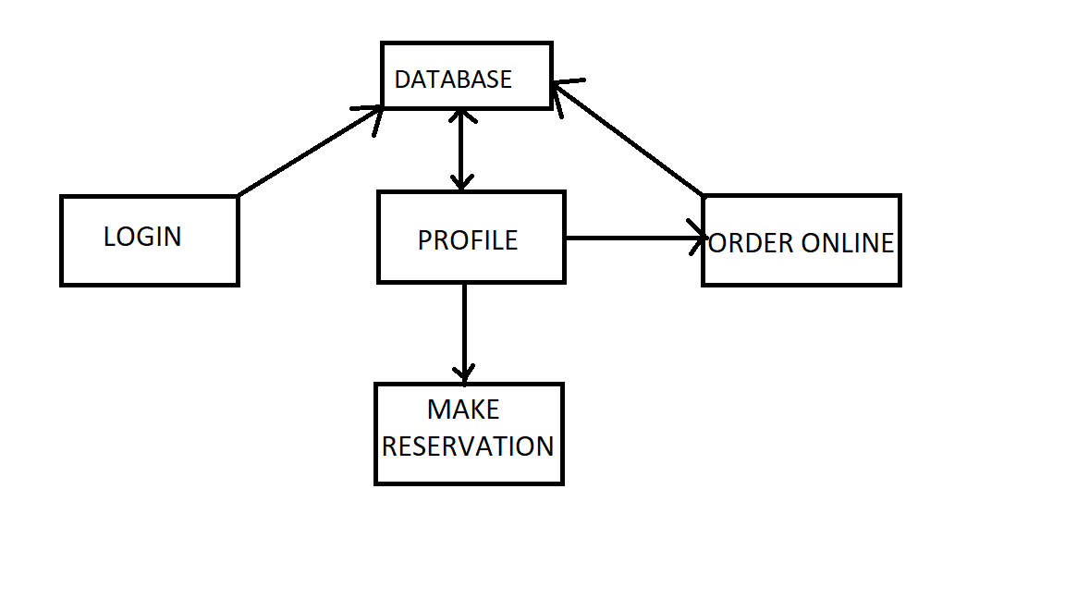
CONCEPT DEVLOPMENT

Slide 9
CONTENT PLANNING
USER -NAME
EMAIL ID
PHONE NUMBER
PREFRENCES

Slide 10

USER INTERFACE DESIGN

Slide 11
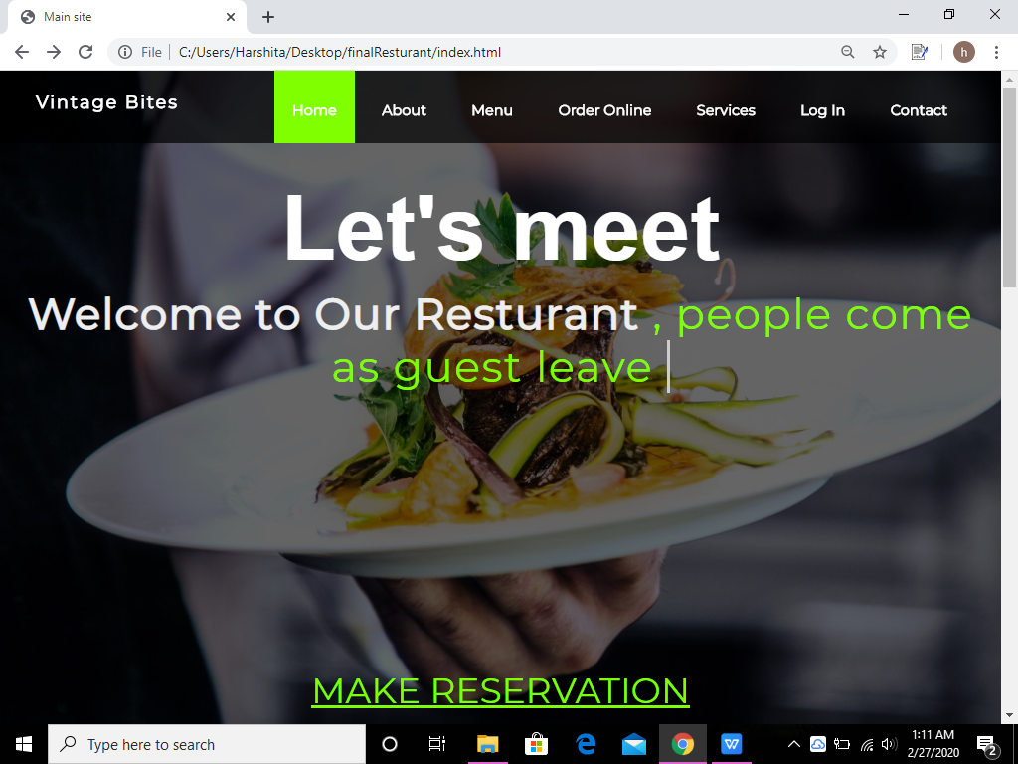
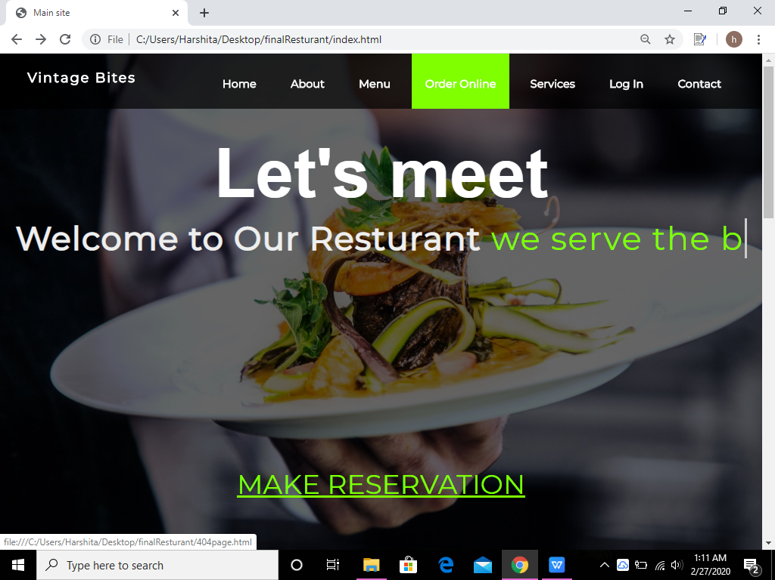
This is made by using type js. Its has 3 statement consecutively
Index Page Layout:

Slide 12
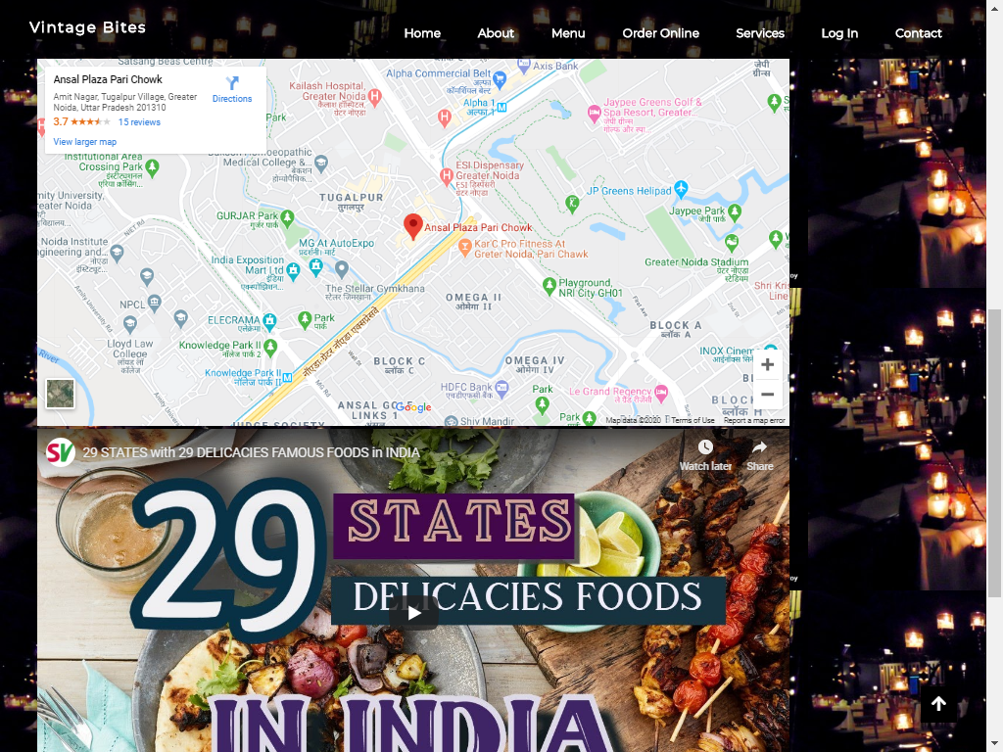

Slide 13
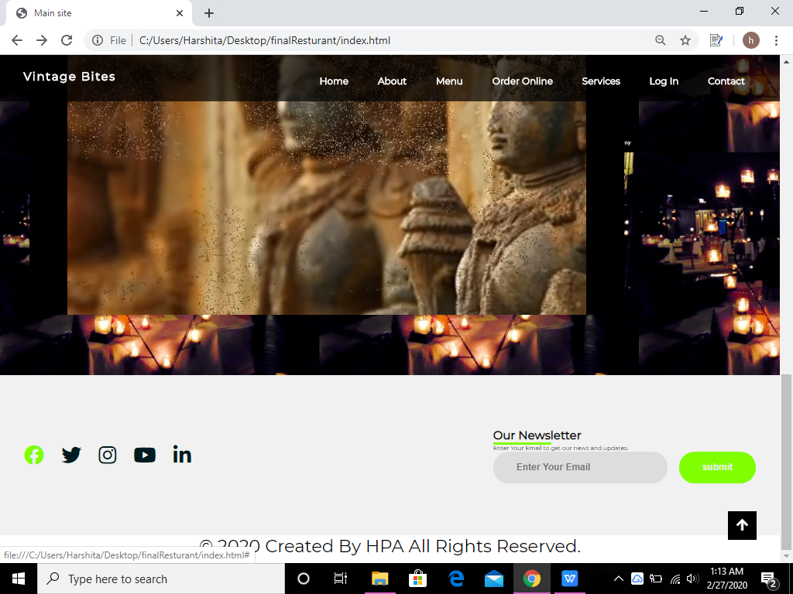
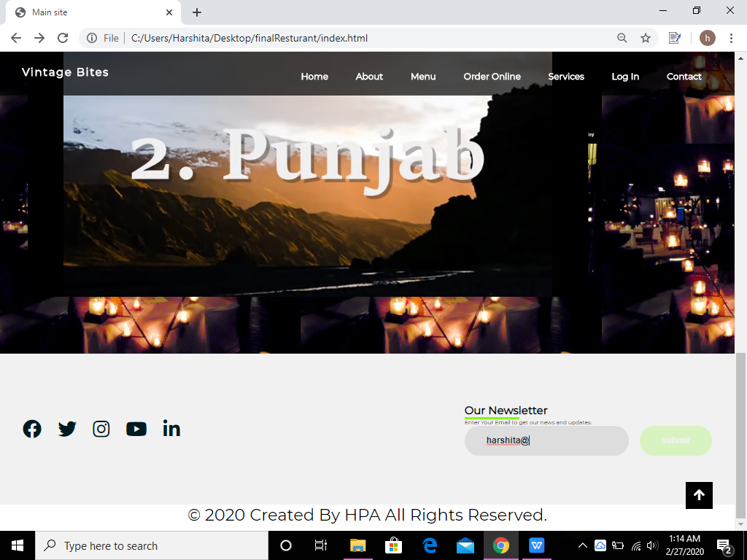

Slide 14
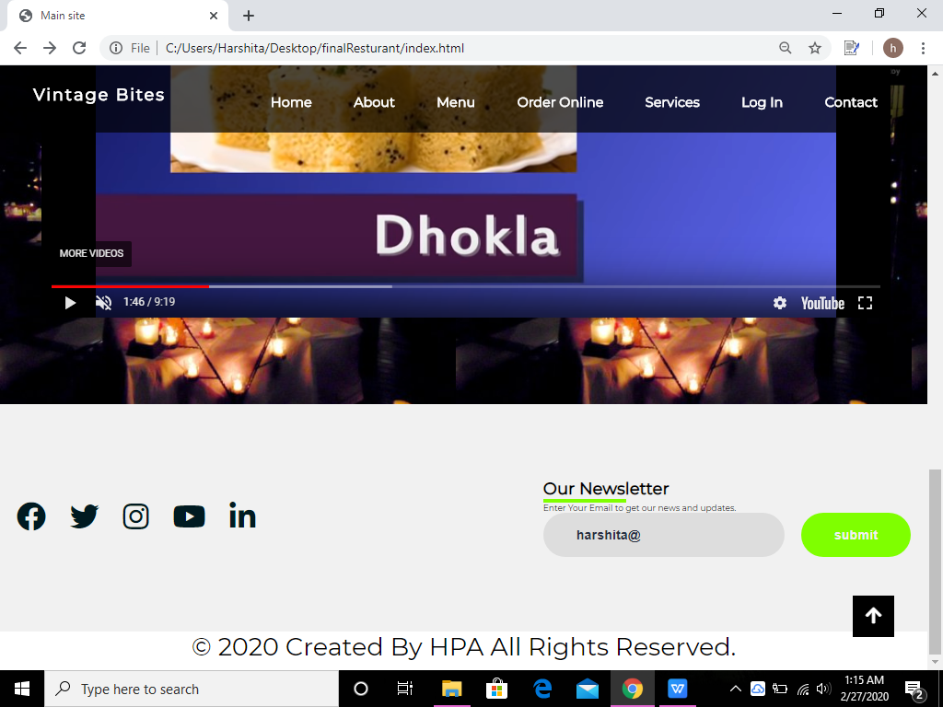
This is scroll up button when you will click this it will take up at the top of website .This is made usig Javascript.

Slide 15
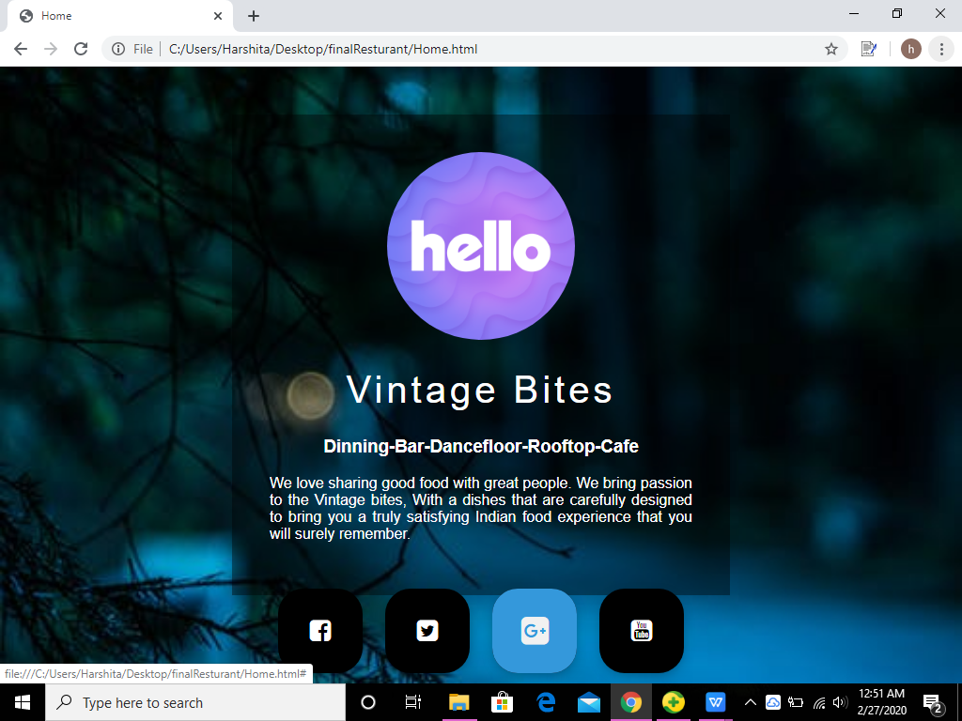
Home Page Layout:

Slide 16
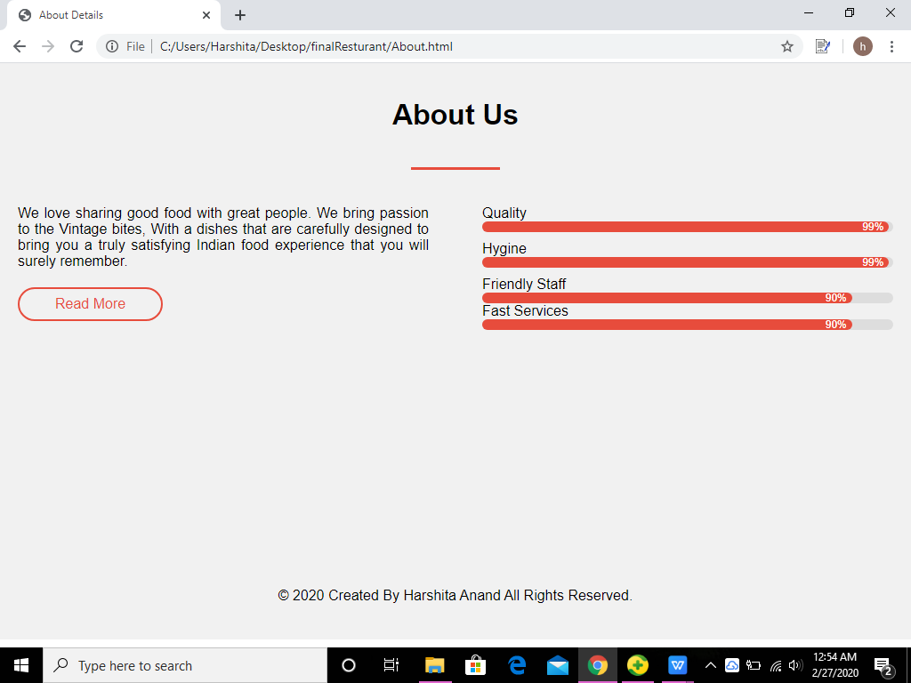
About Page Layout:

Slide 17
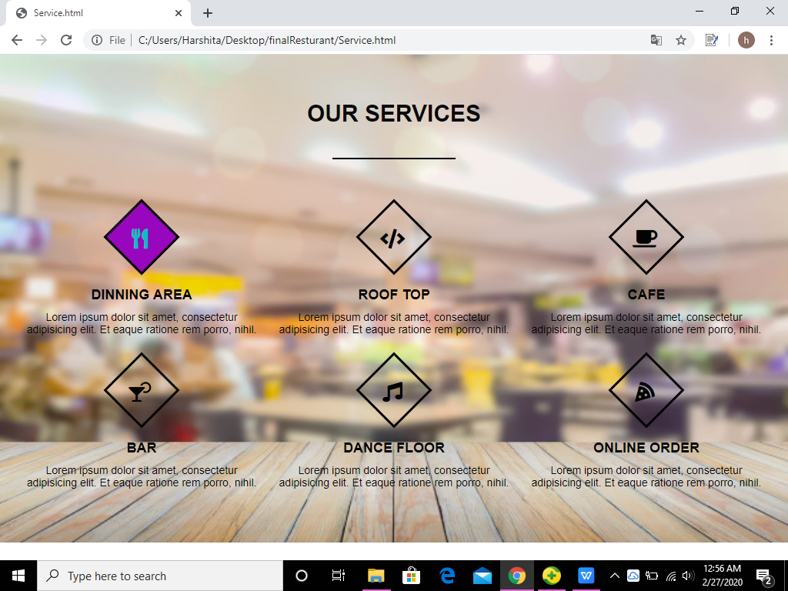
Service Page Layout:

Slide 18
4
TESTING

Slide 19
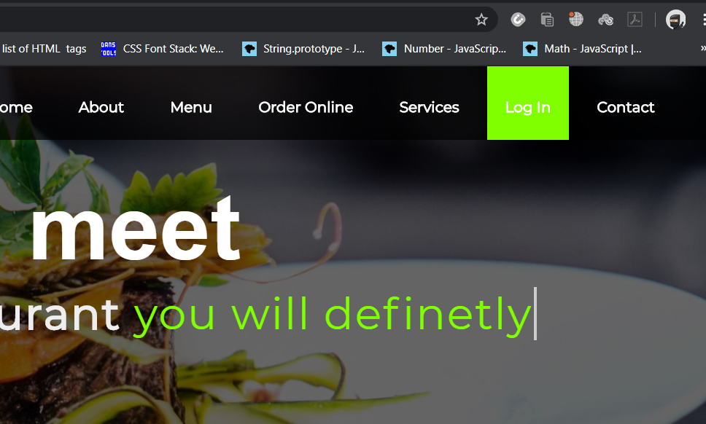
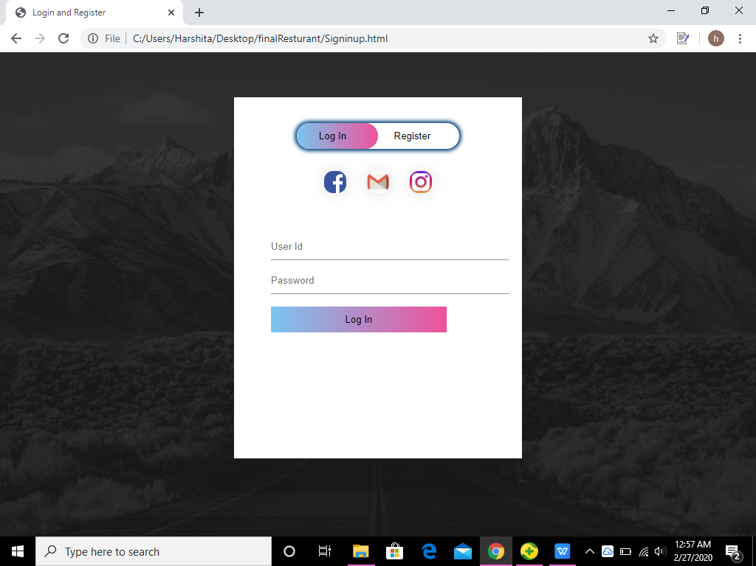
On Click Log in

Slide 20
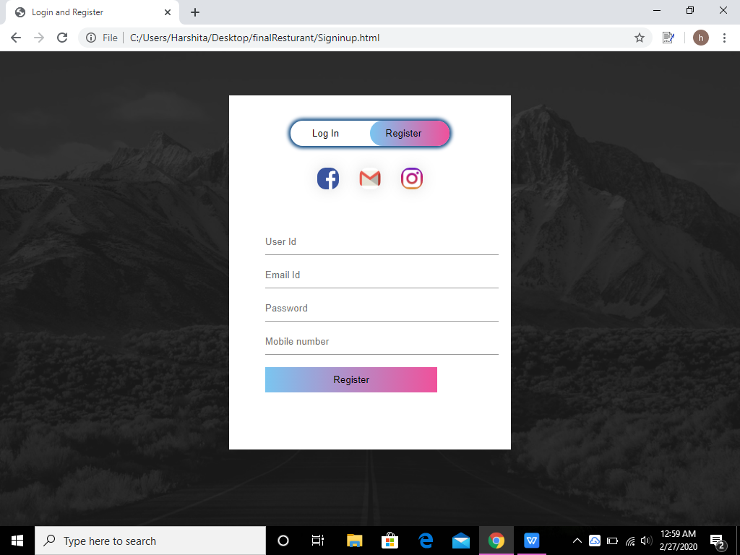
Register Page Layout:

Slide 21
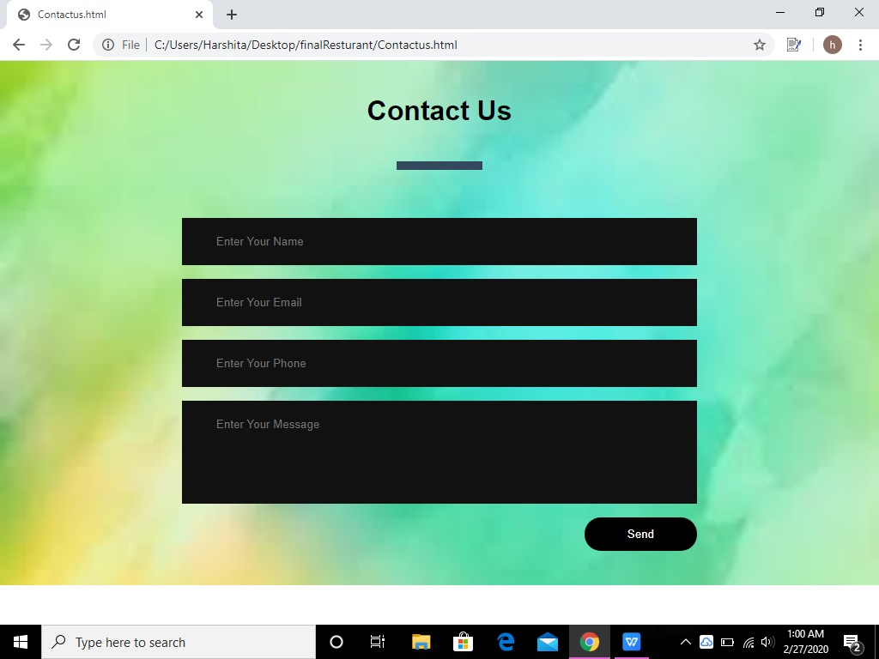
Contact us Page Layout:

Slide 22
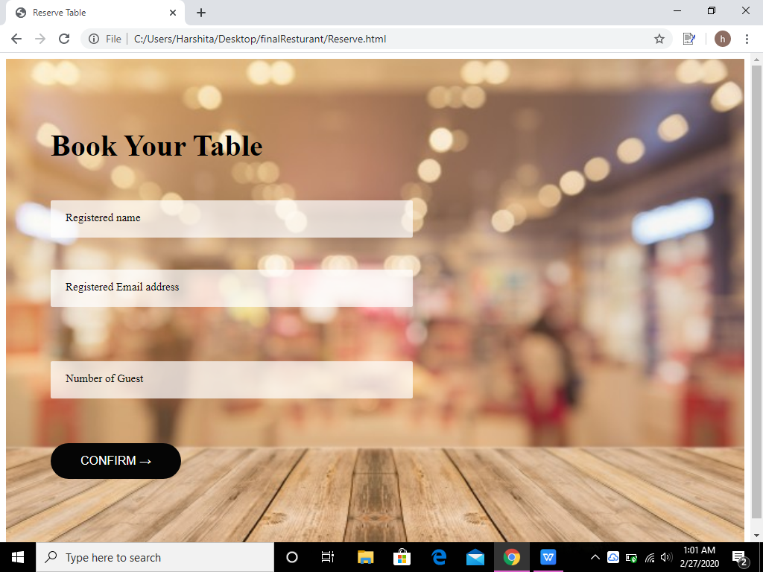
Make Reservation Page Layout:

Slide 23
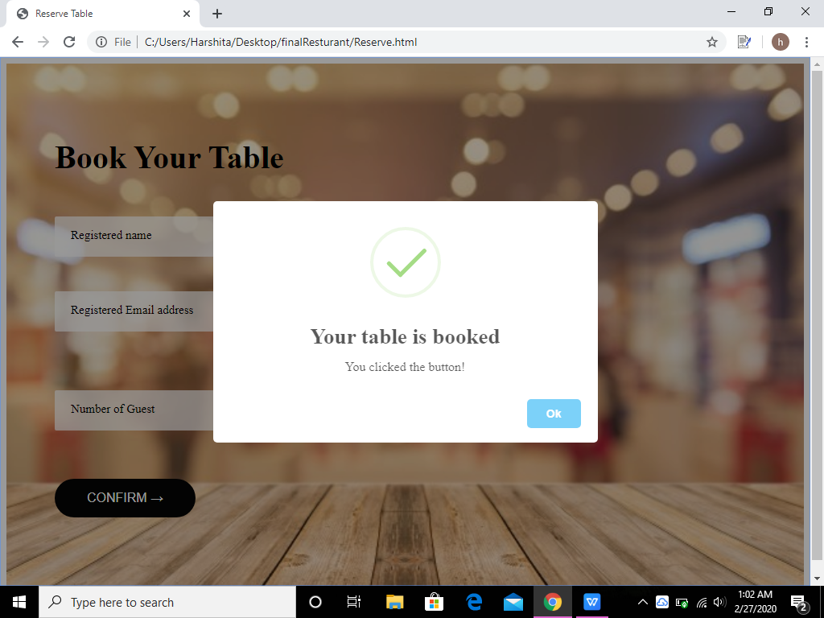
On clicking confirm in book your table:

Slide 24
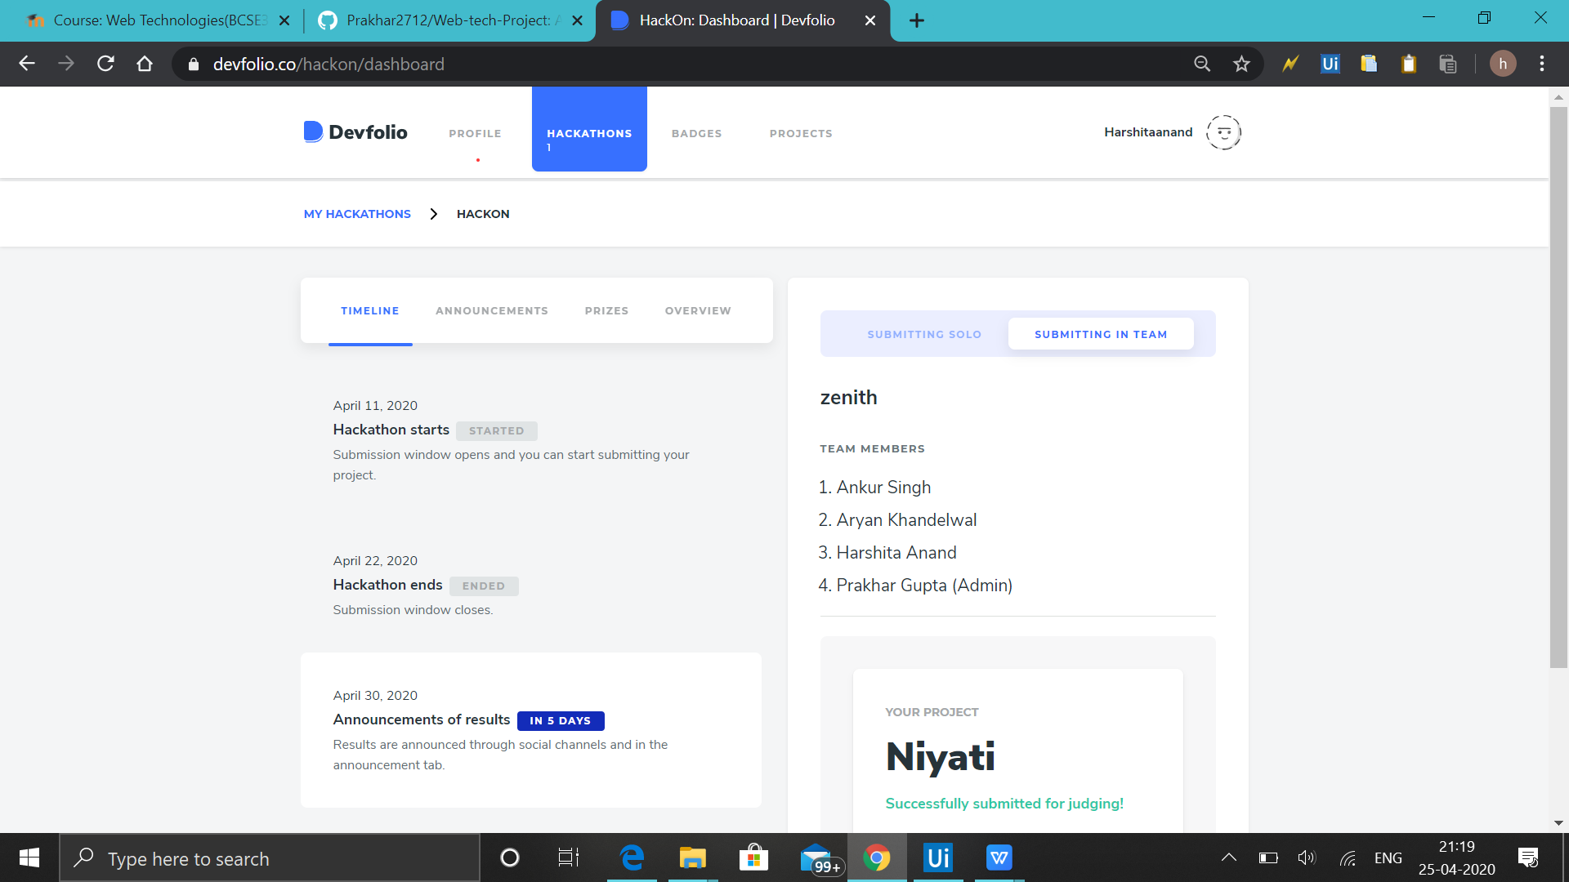
Extra Circular:
We took part in DEVFOLIO and made website on COVID-19 which is named as NIYATI .
The project is still under evaluation and it will get evaluated on 30th April 2020

Slide 25
THANK YOU

